Slide 1
Radar Signal Processing with RFSoC
Danielle Rivera

Slide 2
Spectrum Analyzer
Processing System
AXI4-Stream
Channelizer (FFT) Algorithm
-Designed in Simulink and code generated using HDL Workflow Advisor
NCO Single Frequency Tone Generation
ADC
DAC
User-defined settings (Fs, samp/clock, etc)
Loopback
User-defined settings (Fs, samp/clock, etc)

Slide 3
Hardware-Software Co-design for RFSoC
Mimeo: p. 118

Slide 4
Create model, separate algorithm for fpga into its own subsystem, ensure entire model is functioning, then select the fpga subsystem – right click – HDL Code – HDL Workflow Advisor
Run all tasks individually and ensure all options are adjusted as needed, details in following slides
Any changes made to previous steps– or even looking at other options without changing anything – will require all tasks from the changed on forward to be rerun

Slide 5
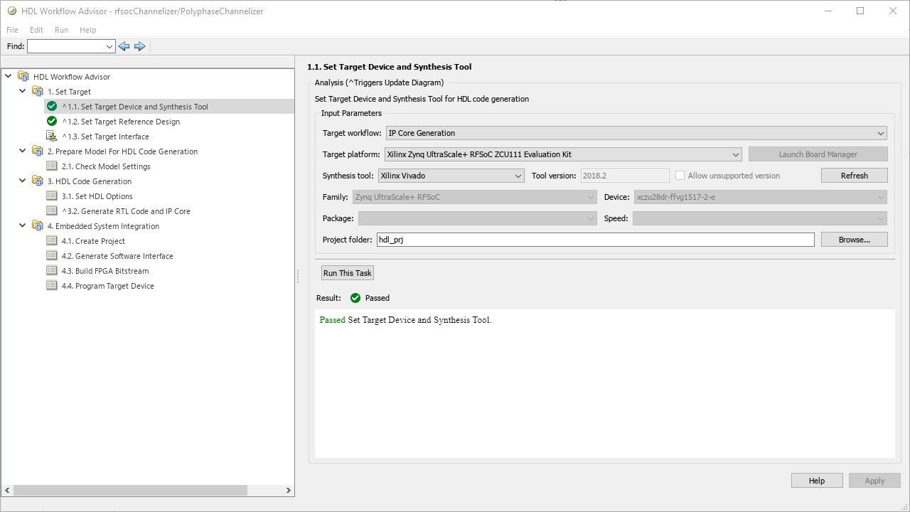
Ensure IP Core Generation for ZCU111 board is selected (can do other boards if needed)

Slide 6
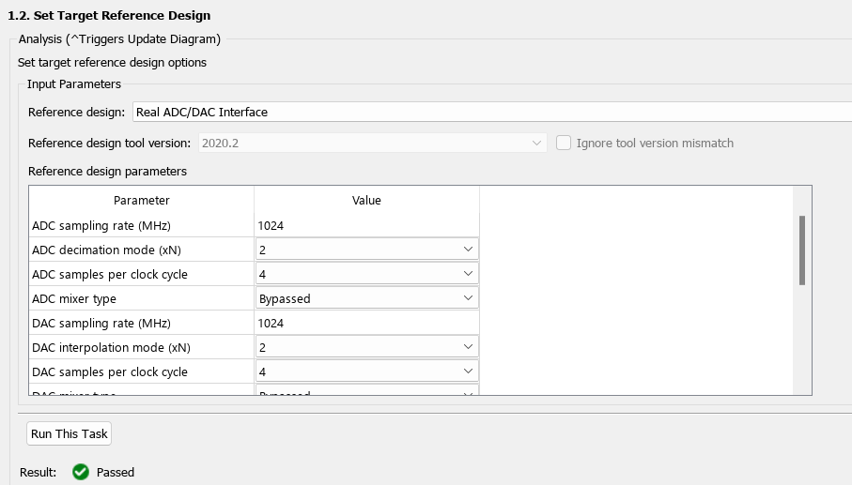
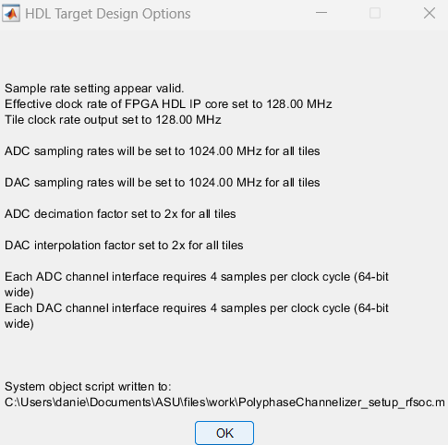
Set parameters for the clock, ADC and DAC sampling rates, and other frequency plan factors based on the ADC/DAC
Confirmation popup will show what you set for effective clock rate, sampling rates, decimation/interpolation factor, and samples/clock
- Verify they match what you intended to set

Slide 7
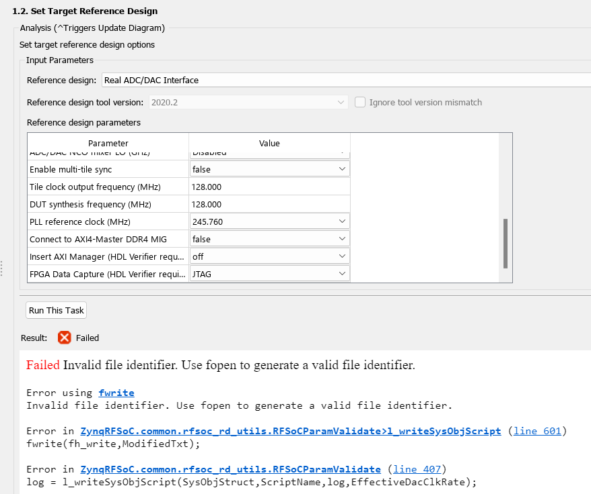

Slide 8
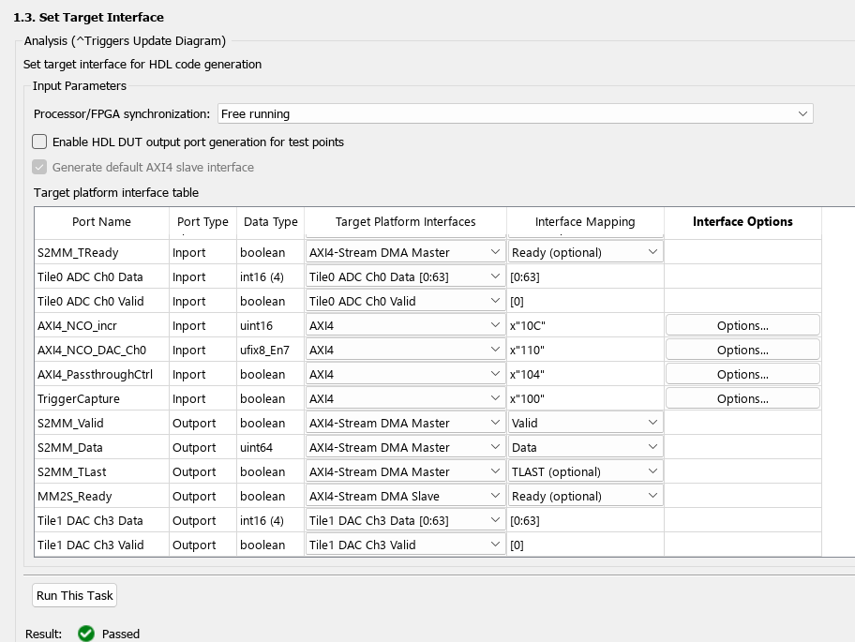
Most things do not change here, but need to ensure ADC and DAC data and valid target platform interfaces match the port names (Tile and Channel numbers)

Slide 9
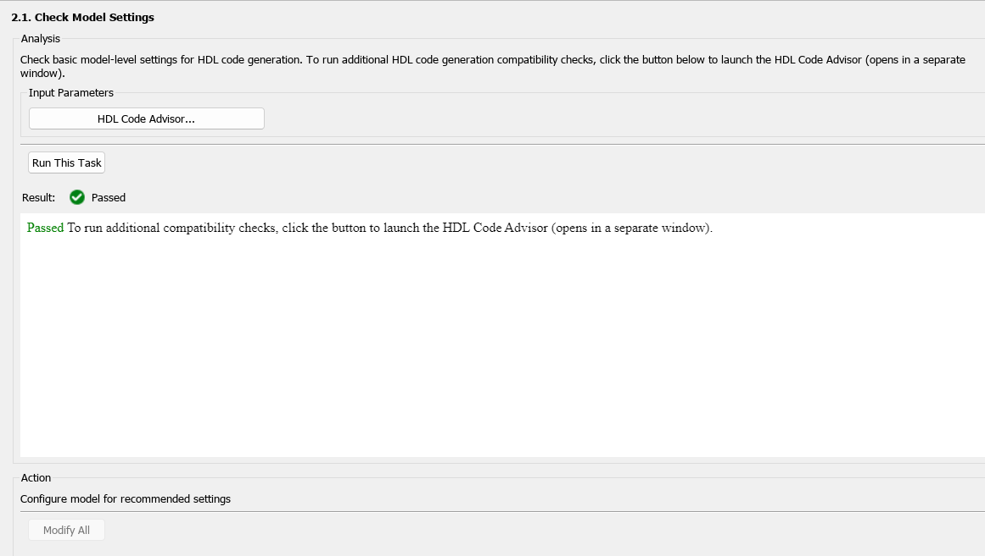
Section 2 only requires one task to run, and you can generally hit “modify” or “fix all” for any warnings or errors that appear.
To ensure code compatibility open the HDL Code Advisor and run all checks – warnings will pop up and be explained for you to ignore or fix as needed

Slide 10
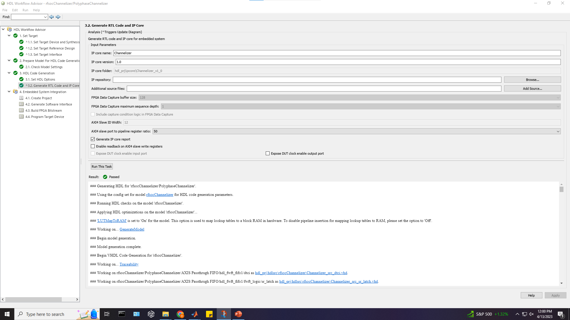

Slide 11
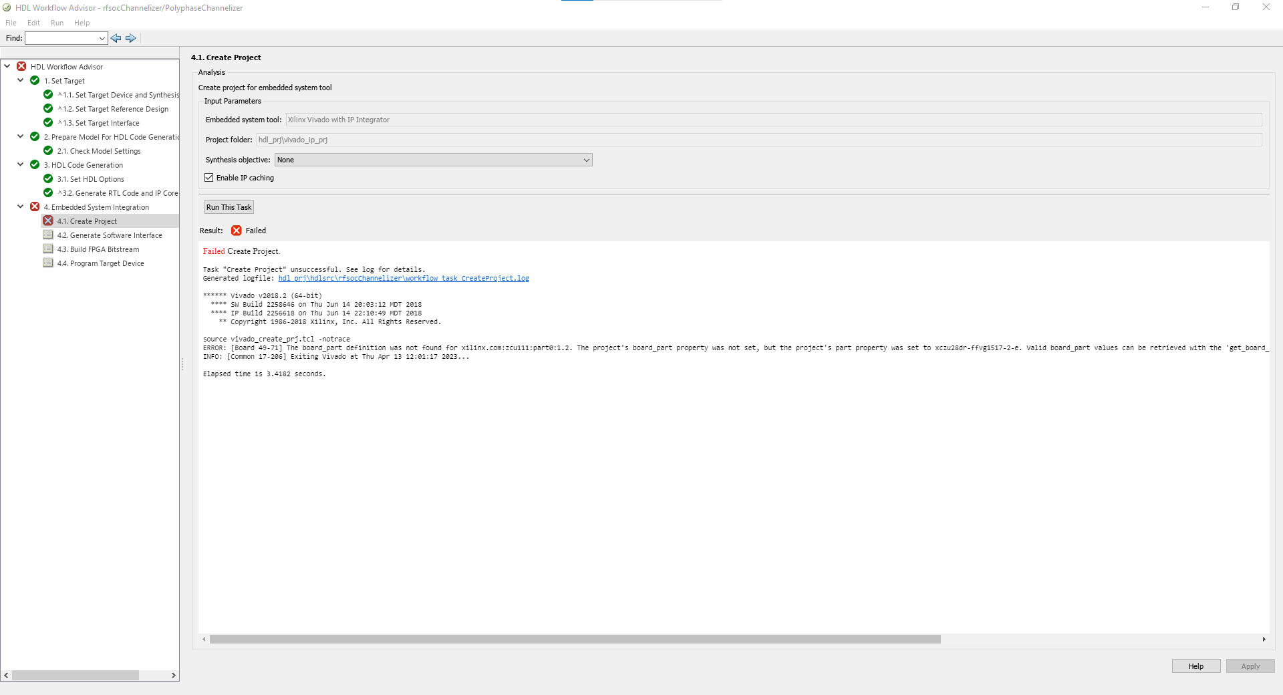

Slide 12
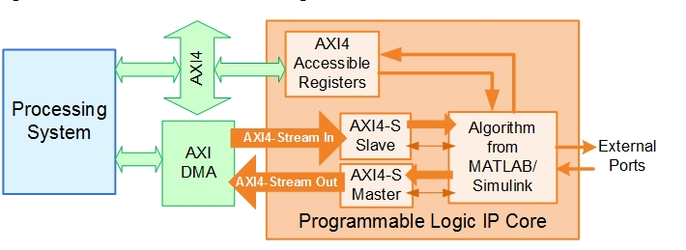
RF Output Spectrum
Embedded Software
ADC/DAC
Polyphase Channelizer

Slide 13
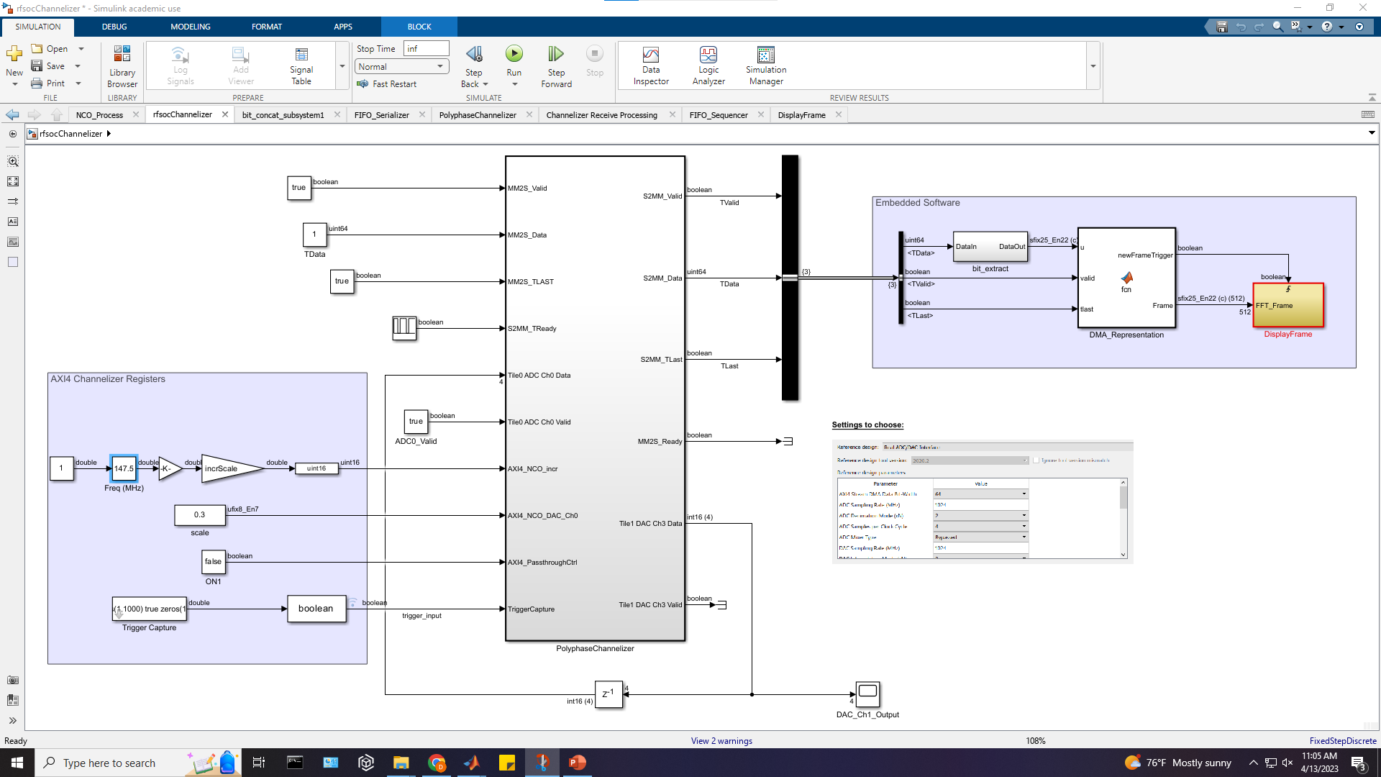
RF Channelizer
Rx Output spectrum

Slide 14
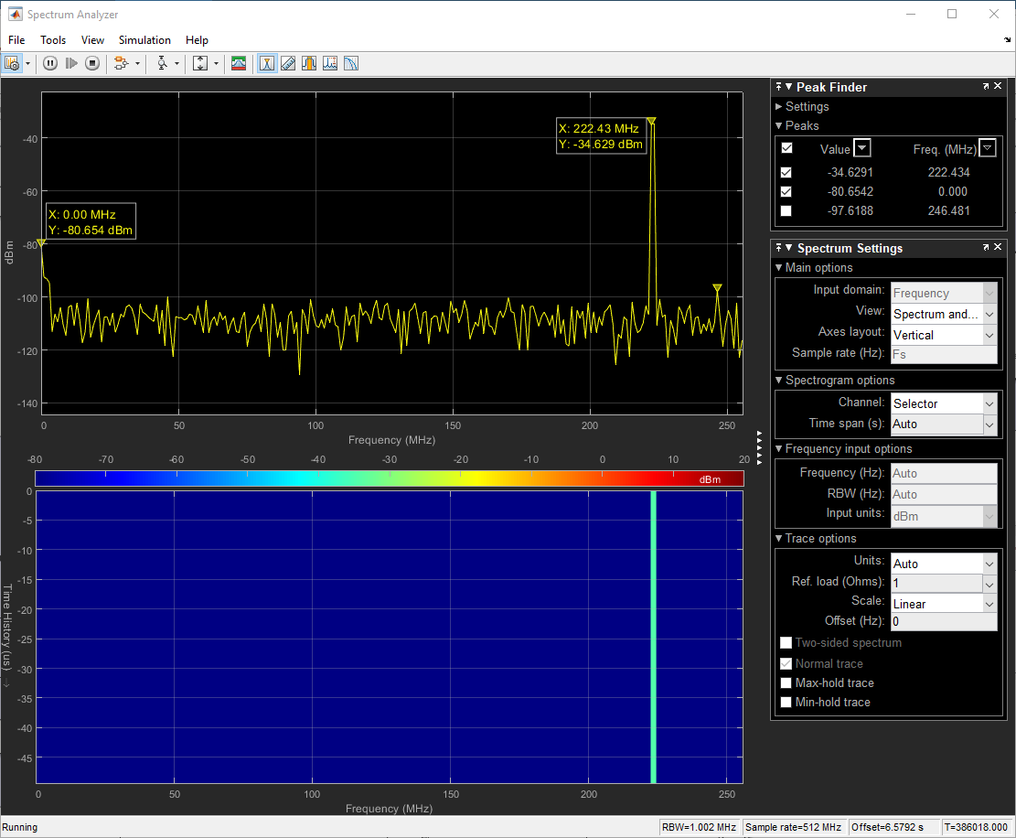

Slide 15
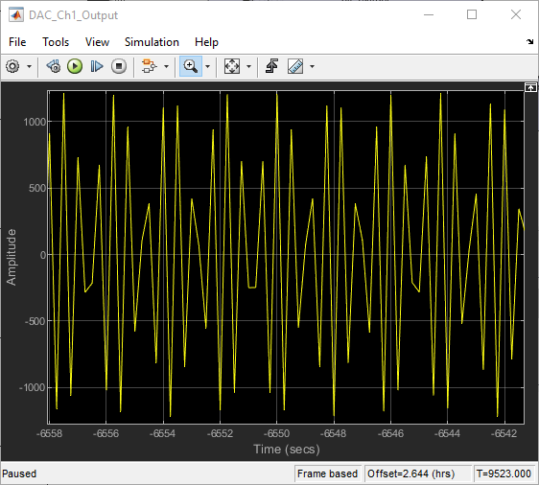

Slide 16
Loopback on FPGA

Slide 17
FPGA DAC/ADC Photo

Slide 18
SD Card Setup
https://www.mathworks.com/help/supportpkg/xilinxrfsocdevices/ug/guided-sd-card-setup.html
https://www.xilinx.com/support/documents/boards_and_kits/zcu111/ug1271-zcu111-eval-bd.pdf
- Section 2 for SD Card

Slide 19
Switch Settings
https://www.mathworks.com/help/supportpkg/xilinxrfsocdevices/ug/board-specific-setup-information.html
Steps for ZCU111 board setup

